Slide 1
Employee Data Analysis using Excel
STUDENT NAME : Sree Mirthika M
REGISTER NO : 122200934, EC65DE5B69CEFCBBD0F4988D024C41BD
DEPARTMENT : Bachelor of Commerce (Corporate Secretaryship)
COLLEGE : K.C.S. Kasi Nadar College of Arts and Science

Slide 2
PROJECT TITLE
Job Title Based on Department Using Excel

Slide 3

AGENDA
Problem Statement
Project Overview
End Users
Our Solution and Proposition
Dataset Description
Modelling Approach
Results and Discussion
Conclusion

Slide 4

PROBLEM STATEMENT
The current distribution of job titles across the Human Resource and Product departments indicates a significant imbalance. The Product department shows a higher concentration of diverse job titles, particularly in technical and engineering roles, while the Human Resource department is underrepresented, with fewer and more limited roles. This disparity may suggest potential inefficiencies in resource allocation, hiring practices, or departmental growth strategies. The organization needs to assess whether this distribution aligns with its overall business objectives and whether it is sustainable for long-term success.

Slide 5

PROJECT OVERVIEW
The "Job Title Based on Department" project aims to analyze and address the distribution of job titles across different departments within the organization. Specifically, the project will focus on understanding the significant disparity between the Human Resource and Product departments.
The Product department currently has a wide variety of job titles, particularly in technical and engineering roles, whereas the Human Resource department is underrepresented, with limited roles concentrated mostly in management. This project will investigate the causes and implications of this imbalance, assessing whether it aligns with the organization's strategic goals and identifying areas for potential improvement.

Slide 6

WHO ARE THE END USERS?
• Human resources (HR) Department
• HR Analysis
• Department Heads and Managers
• Human Resources Department
• Executive Leadership Team
• Organizational Development Teams
• Employees
• Senior Management
• Professionals

Slide 7
OUR SOLUTION AND ITS VALUE PROPOSITION
✓ Filtering : To fit data into equations, change the size of rows and columns, or shrink a worksheet to fit.
✓ Removing Duplicate : To remove duplicate entries from a table.
✓ Conditional formatting : Makes it easy to highlight certain values or make particular cells easy to identify.
✓ Pivot Table : To summarize, organize, and analyze large amounts of data.
✓ pivot chart : That allows you to create interactive charts from pivot tables.

Slide 8
Dataset Description
First Name : He first of your names that come before your family name.
Last Name : a name that identifies a person's family and is different from their given name.
Email :An email is a form of electronic communication that allows users to send messages to other users over the internet.
Gender : Is a social, psychological, and cultural construct that is developed through socialization and varies from society to society.
Department :A part of an organization such as a school, business, or government that deals with a particular area of study or work.
Job title : A job title is a formal name for a position within an organization that can include the position's name, the organization's name, and sometimes the name of the person who holds the position.
Years of experience: Is a term that refers to how long a candidate has worked in a particular industry or field.
Salary : The money that a person receives (usually every month) for the work he/she has done

Slide 9
MODELLING
✓ Downloaded dataset from kaggle website
✓ Extracted from zip format
✓ Using alignment in Excel for clear and presentable
✓ Changing the size of rows & Columns of the given data
✓ Highlighting certain values using Conditional Formatting
✓ Using ifs formula for cleaner and more organized way to manage multiple conditional checks.
✓ Adding Pivot Tables For quickly summarize large datasets.
✓ Using graphs to making it easier for understand and interpret complex information.
9

Slide 10
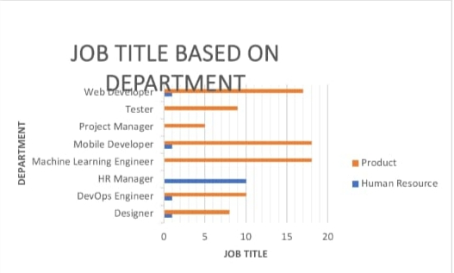
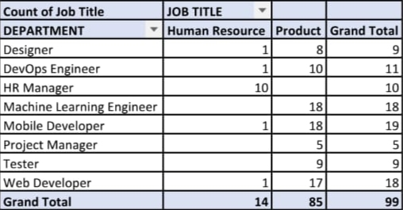
RESULTS
10

Slide 11
CONCLUSION
The job title analysis reveals a significant imbalance between the Human Resource and Product departments, with the latter dominating in diverse roles, particularly in technical fields. This disparity suggests a need for better workforce allocation to ensure alignment with the company’s strategic goals. Balancing job titles across departments will enhance efficiency and support the organization’s long-term success.

